Slide 1
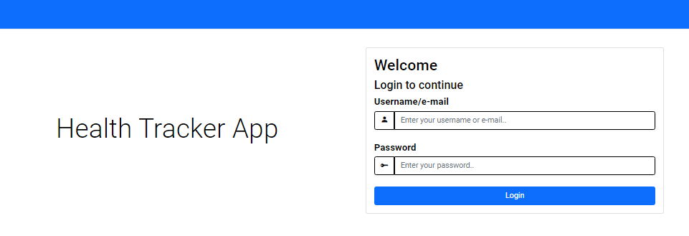
Personal Health Tracker Project
SIVA KOTI REDDY TALAKOLA
LAKSHMI SRICHARAN REDDY MOTATI
THARUN KUMAR ABBURI

Slide 2
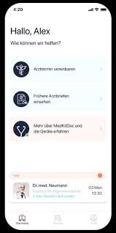
Introduction
Our Personal Health Tracker project emerges as a pivotal initiative in a fast-paced world where health takes center stage. This endeavor is committed to advancing a cutting-edge database system that seamlessly enables individuals to manage and monitor their health information.
Beyond mere data storage, it offers a user-centric platform for recording and analyzing health data, ensuring data security, and empowering users to make informed decisions about their well-being

Slide 3
Problem statement
Many individuals struggle to efficiently manage and monitor their personal health information. Existing solutions lack a comprehensive, user-centric platform for recording, analyzing, and visualizing health data. Privacy and security concerns discourage active participation in health tracking.

Slide 4
Proposed solution
Our Personal Health Tracker project has the following key features:
User-Centric Design: An intuitive interface for effortless health data input.
Secure Data Storage: Ensuring data privacy and confidentiality.
Health Metric Tracking: Visualizing health metrics for users.
Personalized Health Reports: Generating tailored health reports

Slide 5
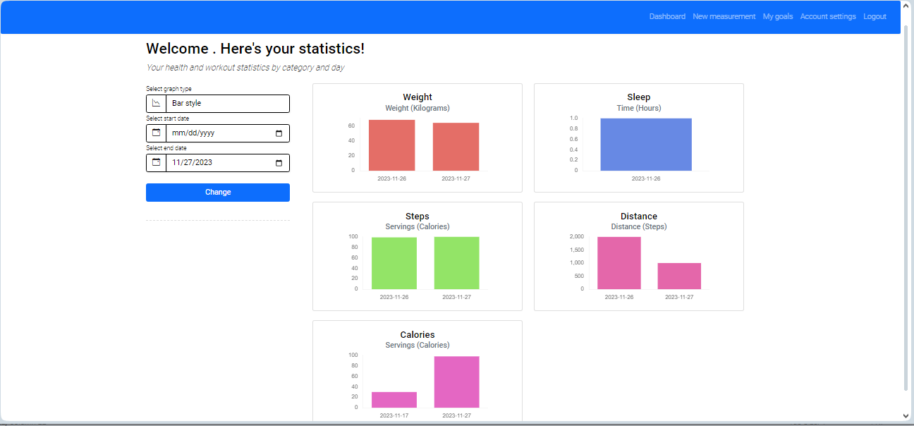
The proposed solution

Slide 6
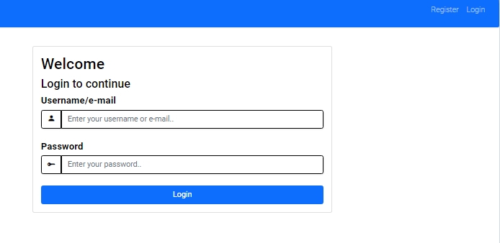
User authentication
Users are authenticated and authorized correctly

Slide 7
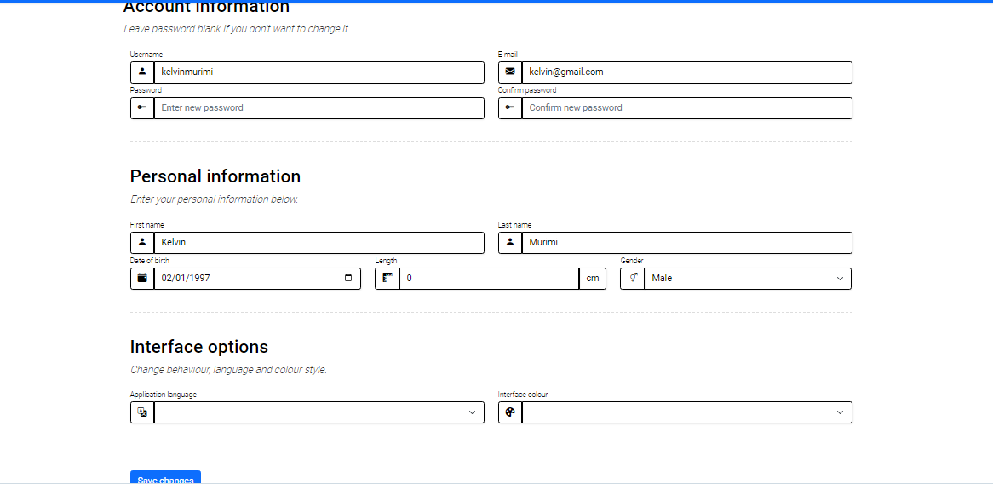
Personal account
User is able to login have their detailed profile including their name, date of birth and an interface to edit their information such as password

Slide 8
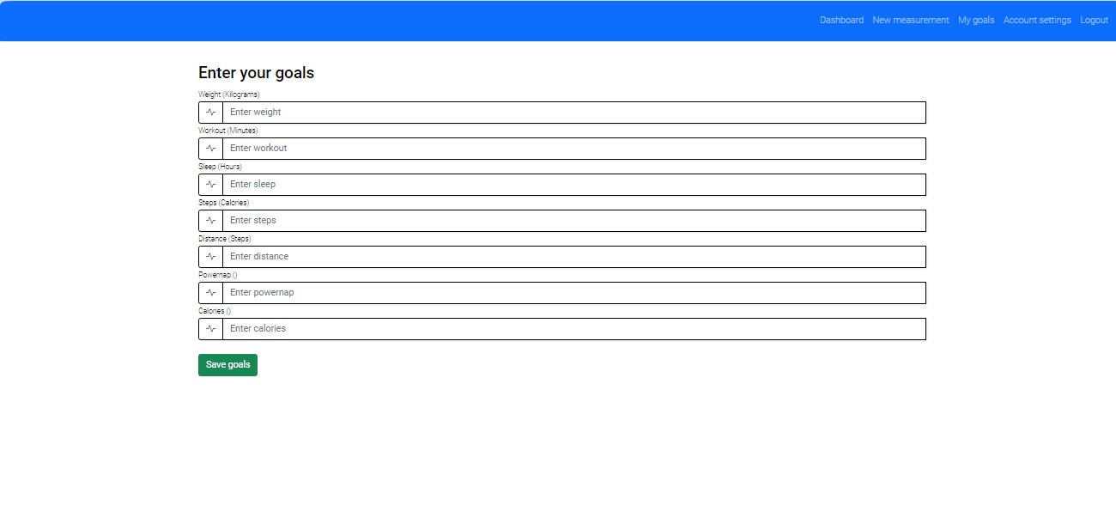
Setting health Goals
User can set the goals they aim to achieve within certain period of time

Slide 9
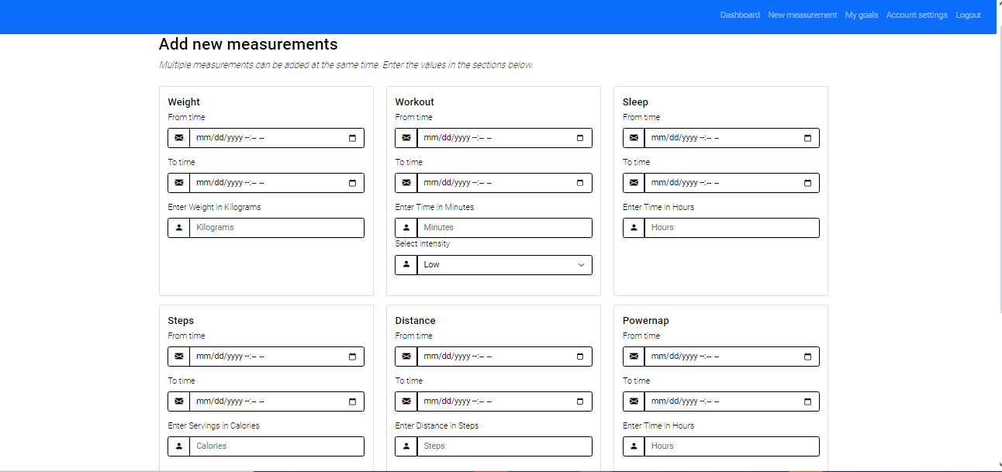
Data input interface
User-Centric Design: An intuitive interface for effortless health data input.

Slide 10
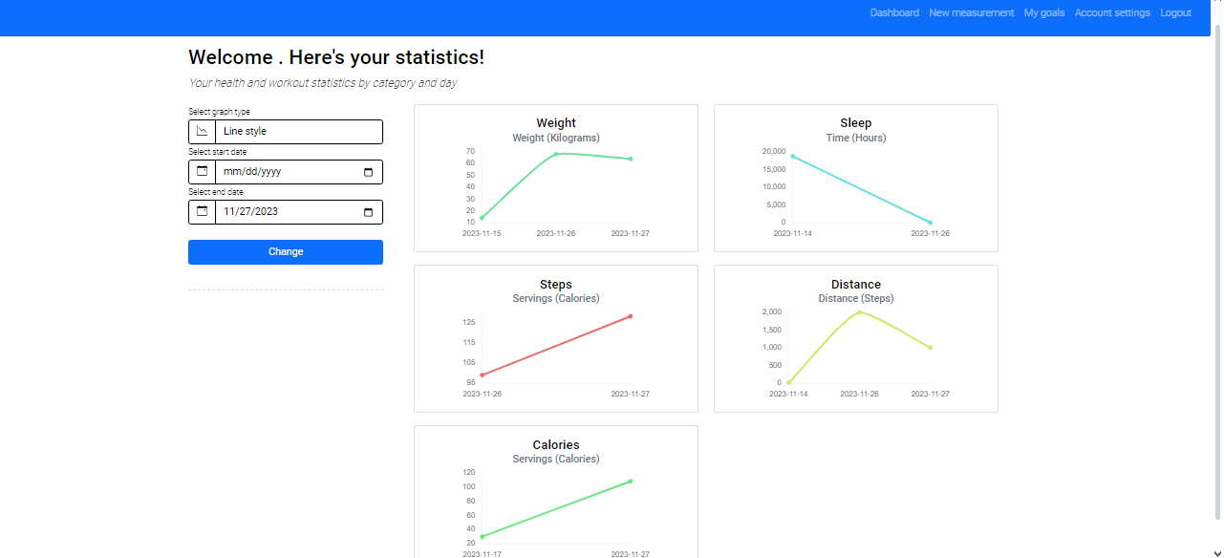
Dashboard
Health Metric Tracking: Visualizing health metrics for users.
Personalized Health Reports: Generating tailored health reports

Slide 11
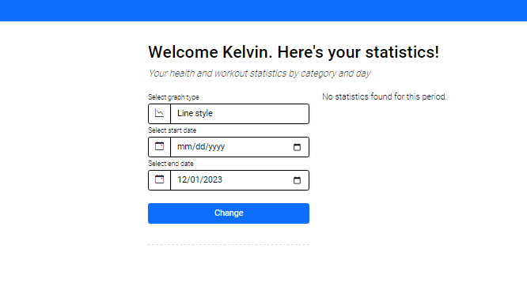
Viewing health data
User can choose how to display their health data ; they can either display the data as bar graph or line graph whichever they deem best

Slide 12
Experiments
Iterative Development Cycle:
Description:
The iterative development cycle, guided by user feedback and security assessments, ensured ongoing improvements. Regular feedback sessions allowed us to identify security concerns and implement measures to address them. This agile approach guarantees that our platform evolves in tandem with user needs and security standards.
User Testing Survey Form:
Description
Our user testing survey form served as a structured tool to collect feedback, including insights on system security perceptions. The form covered user satisfaction, ease of use, and security-related considerations. The feedback obtained from this survey form played a crucial role in refining our security measures.
System Security Assessment:
Description:
An essential component of our testing phase involved a comprehensive assessment of system security. This encompassed identifying security requirements and vulnerabilities. We are actively implementing robust security measures, including data encryption and secure data transmission protocols, to fortify the platform against potential threats.

Slide 13
Discussion
Our Personal Health Tracker project emerges as a pivotal initiative in a fast-paced world where health takes Centre stage
Description: Our user-centric design prioritizes a seamless and intuitive interface for health data entry. This approach ensures that users, regardless of technological expertise, can effortlessly record and monitor their health metrics. The simplicity encourages consistent engagement, making health tracking accessible to a broad user base.
User Benefit: The user-friendly interface enhances engagement and accessibility, promoting consistent health tracking for users of all technological backgrounds.

Slide 14
Conclusion
Project Achievements
Future commitments
The Personal Health Tracker project has successfully addressed critical challenges in personal health management.
By offering a user-friendly platform, robust data analysis capabilities, and a commitment to security and privacy, the project empowers individuals to take control of their well-being.
The Personal Health Tracker can help client visualize their daily routine exercises and set their goals
The project is on track, and the team remains committed to delivering a high-quality solution by the project's conclusion.

Slide 15
Contribution of Team Members
SIVA KOTI REDDY TALAKOLA
Designed user interface for efficient data entry.
LAKSHMI SRICHARAN REDDY MOTATI
Database design and integration
THARUN KUMAR ABBURI
Conducted thorough testing of the system.

Slide 16
Any questions?

